Slide 1
Java Lecture 1

Slide 2
History of Java
Java was introduced in 1991 with the name “Oak” given by James Gosling( a Sun member).
Intermediate Code , “Green Project” and its product “*7” for TV Switch Box.
HotJava Browser to show the strength of language.
In July 1995 its name was changed to Java and in 1996 first version of Java was released named Java 1.0.
Reasons for popularity of Java at that time
  Write once / run anywhere.
  Rich Library.
  Applets, Servlets , Midlets & Application.
  Several versions of Java

Slide 3
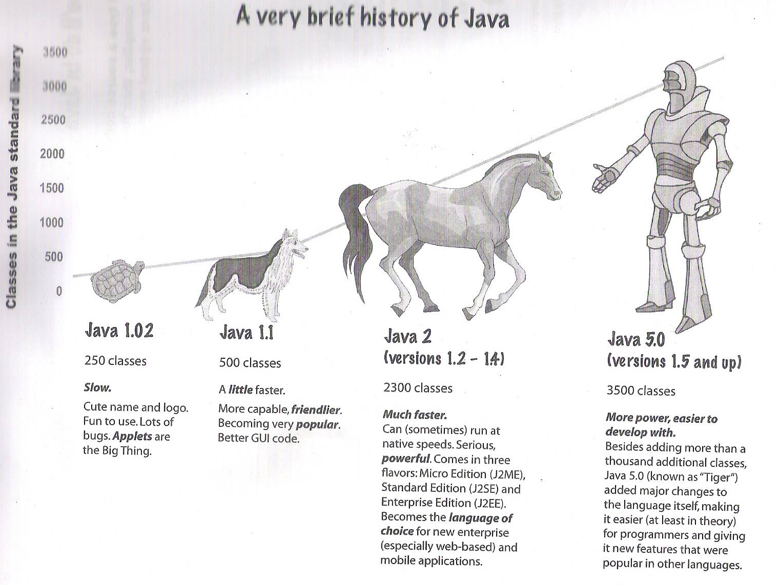
History of Java
Versions of Java

Slide 4
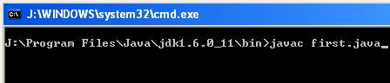
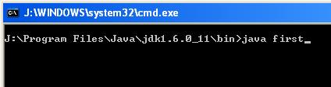
Introduction to Java part 1
Compiler of java : javac
  To compiler a java program(named first) using command prompt:
Interpreter of java : java
  To run a java program(named first) using command prompt:

Slide 5
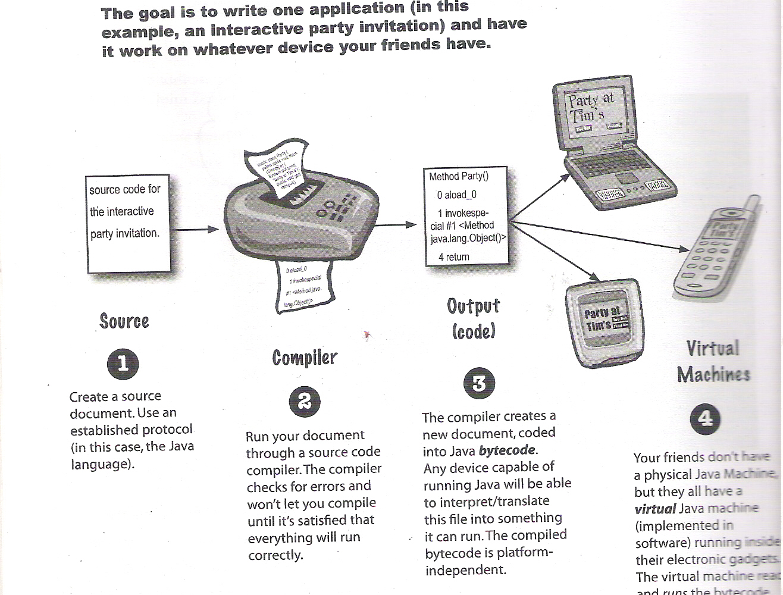
Introduction to Java part 1
Java Virtual Machine

Slide 6
Introduction to Java part 1
compiler interpreter
.java .class output
(javac) (byte code) (java)
Byte code is machine like code.
Byte code = machine code – machine dependency – platform dependency.

Slide 7
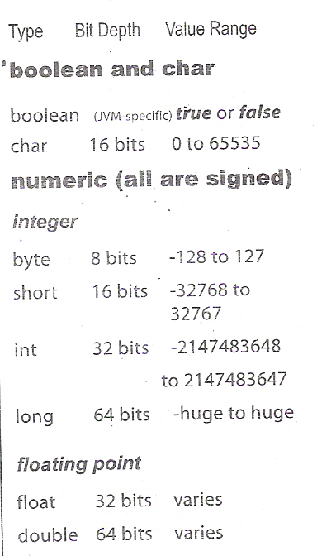
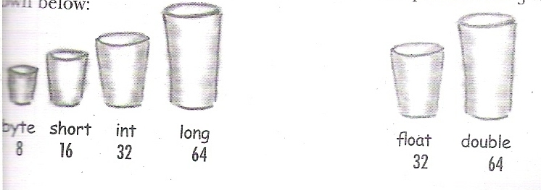
Java Basics
Data Types in Java
Integer type Floating point
Data Type declaration, initialization and variable:
  Syntax:
    Data type variable name[= variable value];
  Example:
    int a;
    float b=1.1;

Slide 8
Java Basics
String Data type/object.
  Declaration and initialization:
    Syntax:
    String string varaible name[=string value];
    Example:
      String a=“ram”;
      String b;

Slide 9
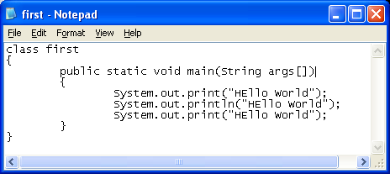
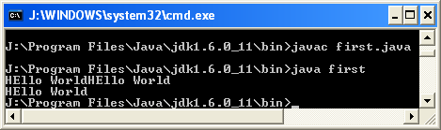
Java Basics
Main () function:
  It is the first function called in the program.
  It is always under the class by which program is saved .
System.out.print() fuction:
  Two forms:-
    System.out.print();
    System.out.println();
Example:

Slide 10
Java Basics
Concatenation( + operator)
    String a=“ram”;
    String b=“mohan”;
    String c=a+b; //c=“rammohan”
    int a=10;
    int b=20;
    String c=“sum=“;
    System.out.println(c+(a+b));

Slide 11
Conditional Branching (if)
Types:
  if statement
    Syntax:
        if(condition[s]) statement
    Example:
        If(a>b) greater =a;
  if / else statement
    Syntax:
        if(condition[s]) statement1 else statement2
    Example:
        If(a>b) greater =a; else greater =b;
  if/ else if….. statement
    Syntax:
        if(condition[s]) statements1else if(condition[s]) statement2…….
    Example:
        If(a>b) greater =a else if(b>c) greater =b;

Slide 12
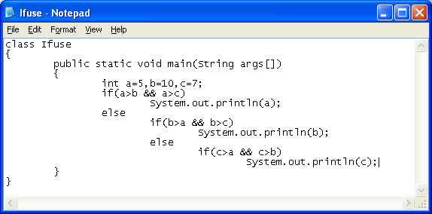
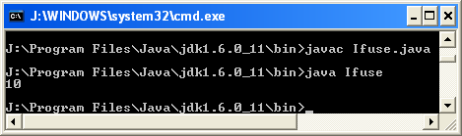
Conditional Branching (if)
Use of AND (&&) and OR(||) with example

Slide 13
YOU COMPILER approach to programming
Compiling this program using u compiler approach to get output.

Slide 14
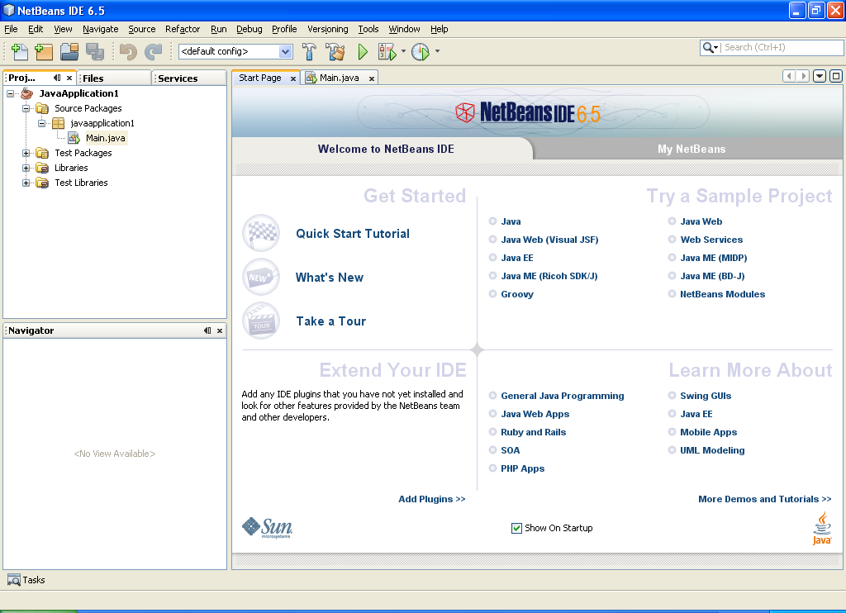
Introduction to Net Beans
It is a IDE for
the Development
of java program
and applications.

